Slide 1
18csc206j SoftwaRE Engineering and project management
Project presentation

Slide 2
Project title – Face mask detection
Submitted by –
Ashish Prakash Singh (RA2011033010060)
Nilay (RA2011033010056)
Karan Keshri (RA2011033010044)

Slide 3
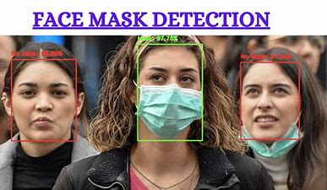
Sample-

Slide 4
INDEX
ABSTRACT
PROBLEM STATEMENT
BENEFITS
LIMITATIONS
METHODODLOGY
STAKEHOLDERS
REQUIREMENTS
EFFORT AND COST ESTIMATIONS
WORK BREAKDOWN
TIMELINE
RISK MANAGMENT
USE-CASE, CLASS, ARCHITECTURE DIAGRAMS
ER DIAGRAM
DATA FLOW DIAGRAM
SEQUENCE AND COLLABORATION DIAGRAM
TEST CASES
CODE DESIGN AND IMPLEMENTATION
CONCLUSION

Slide 5
Abstract-
COVID-19 pandemic has rapidly affected our day-to-day life disrupting the world trade and movements. Wearing a protective face mask has become a new normal. In the near future, many public service providers will ask the customers to wear masks correctly to avail of their services. Therefore, face mask detection has become a crucial task to help global society.
This project presents a simplified approach to achieve this purpose using some basic Machine Learning packages like TensorFlow, Keras, OpenCV. The proposed method detects the face from the image correctly and then identifies if it has a mask on it or not. As a surveillance task performer, it can also detect a face along with a mask in motion. The method attains accuracy up to 97.77% respectively on two different datasets. We explore optimized values of parameters using the Sequential Convolutional Neural Network model to detect the presence of masks correctly without causing over-fitting.

Slide 6
PROBLEM STATEMENT
The main objective of the face detection model is to detect the face of individuals and conclude whether they are wearing masks or not at that particular moment when they are captured in the image or in Video.
With the advancements in technology that the world has been witnessing, there are various available techniques that could prove valuable to society if used effectively. A real-time system which could itself classify, seeing a person, in two categories :
1. A person wearing a face mask
2. A person not wearing a face mask

Slide 7
bENEFITS
This will help many organization to detect whether people are wearing facemask or not.
This will be helpful to implement government protocol.
This will reduce manual labour cost.

Slide 8
limitations
Involve too many machine learning concepts and complexities.
Due to camera quality or low face visibility it might be chances that
it will lead issue in detects face
High setup cost.

Slide 9
METHODODLOGY
We are going to use Agile model for our project implementation.
Agile SDLC model is a combination of iterative and incremental process models with focus on process adaptability and customer satisfaction by rapid delivery of working software product. Agile Methods break the product into small incremental builds. These builds are provided in iterations.

Slide 10
Stackholder
This project will be either funded by government of private company
who strictly follow government.
It will be also sponsored by camera company.
It will also sponsored by advertising company.

Slide 11
Requirements
Camera (1080p, 720p)
Screen
Proper battery backup.
Proper understanding of YOLO algorithm in Machine Learning.

Slide 12
Effort and cost estimation
E = 2.4*(150)^1.05 = 2.4*192.706 = 462.495MM
Time = 2.5*(462.495)^0.38 = 2.5 * 10.297= 25.74~ 26 Months
Person required = E/Time = 462.495/26 = 17.78~ 18 Persons
Modules:
● Login Module — 20 KLOC
● Home Module — 50 KLOC
● Detection Module — 30KLOC
● Feedback Module — 20 KLOC
● Calculation Module — 30 KLOC
---------------------------------------------
Total — 150KLOC

Slide 13
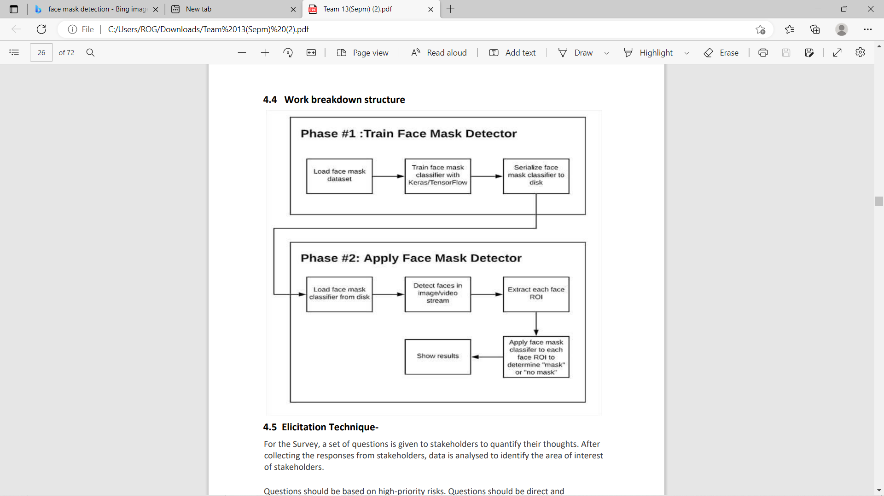
Work breakdown

Slide 14
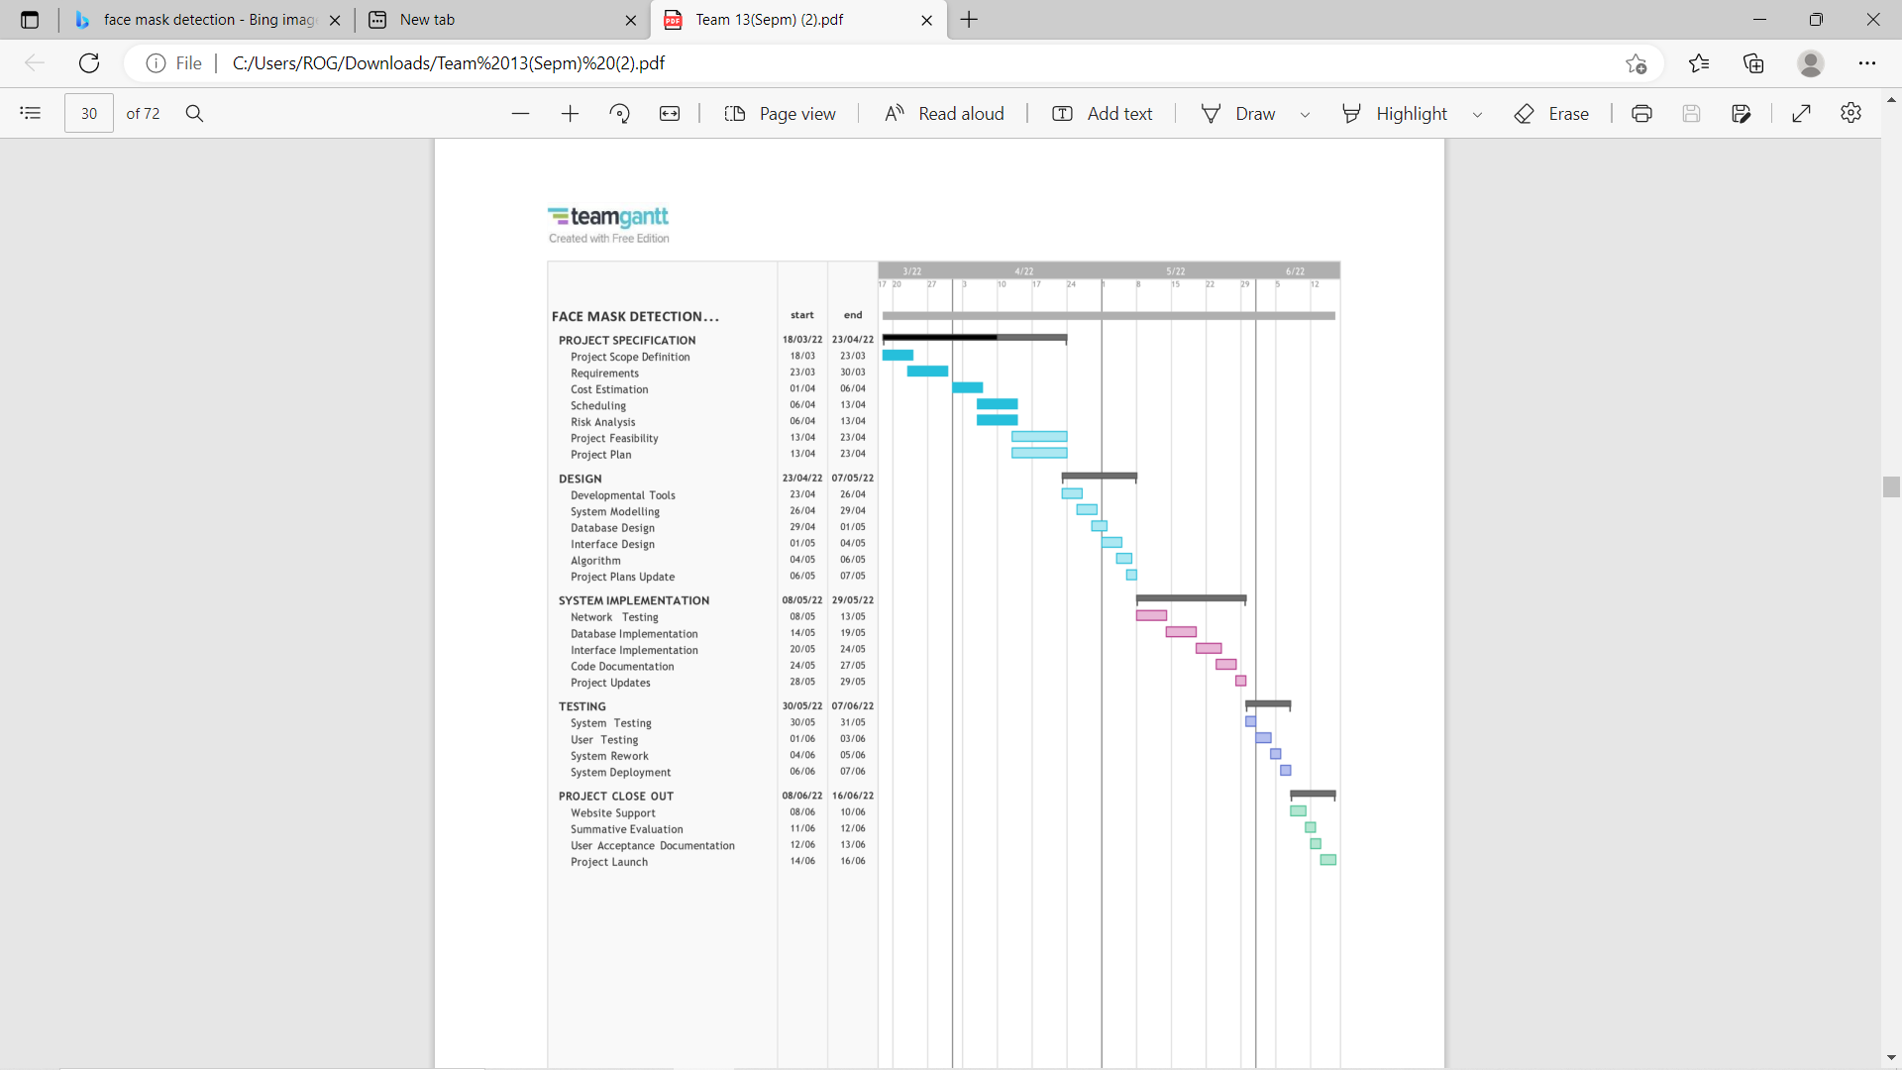
Timeline

Slide 15
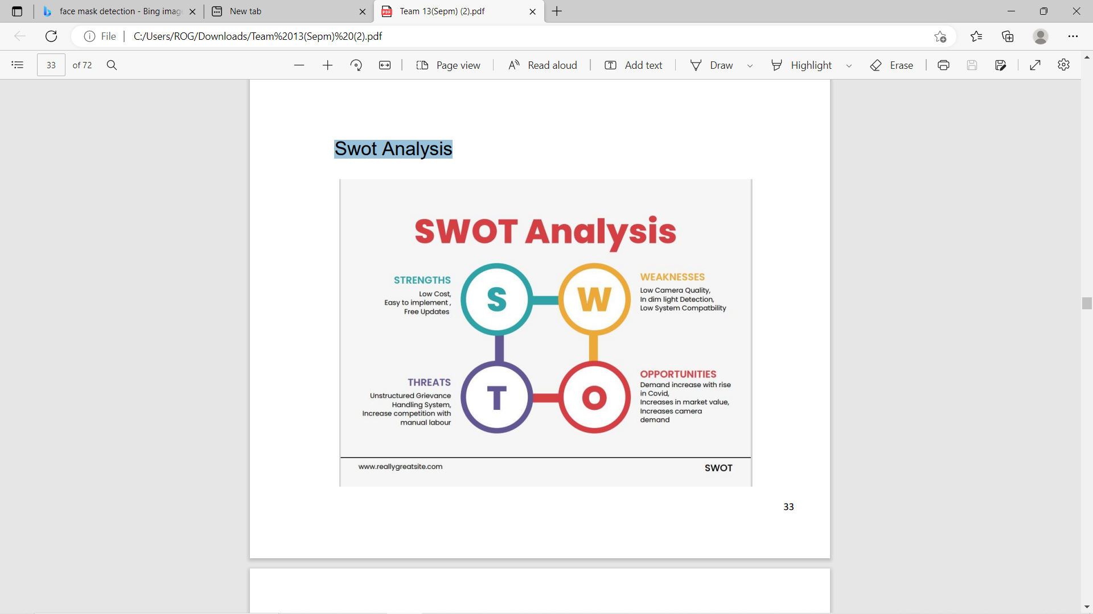
Risk management
SWOT ANALYSIS

Slide 16
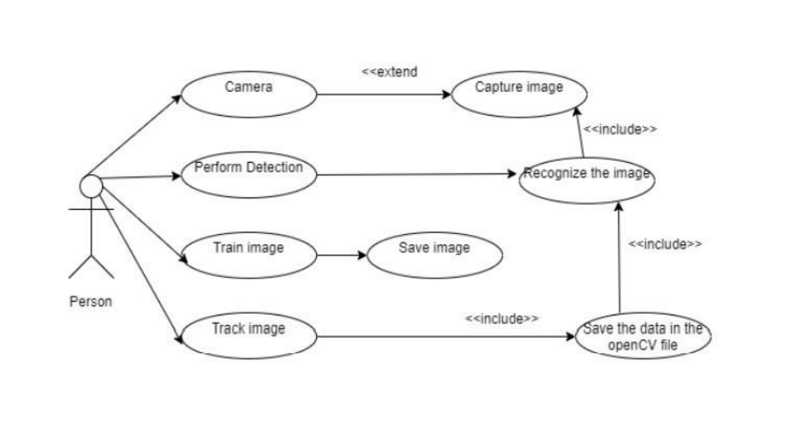
USECASE Diagram

Slide 17
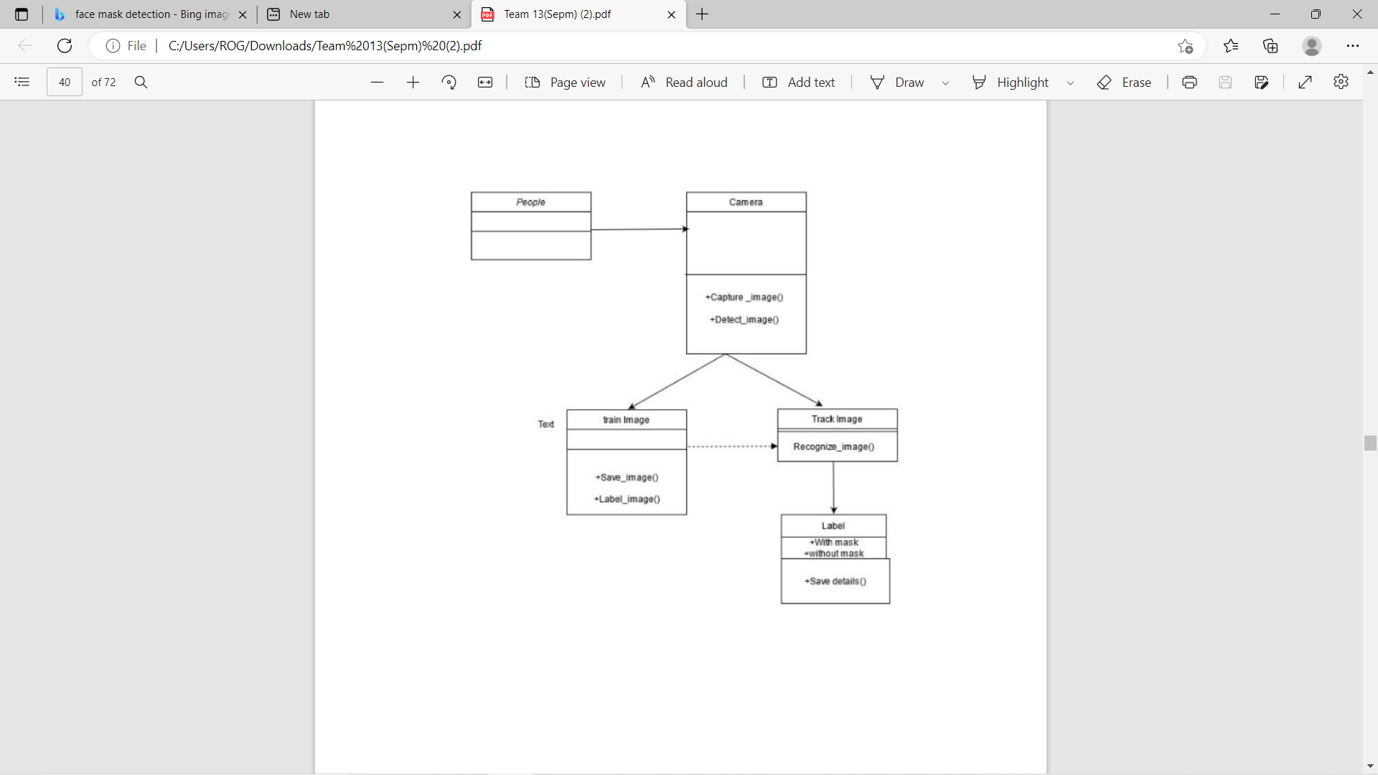
Class diagram

Slide 18
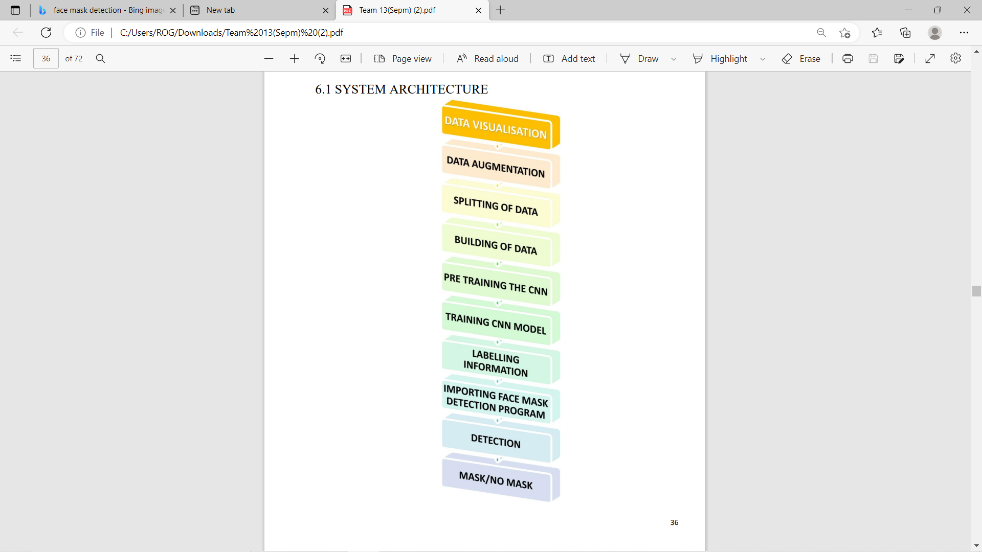
Architecture diagram

Slide 19
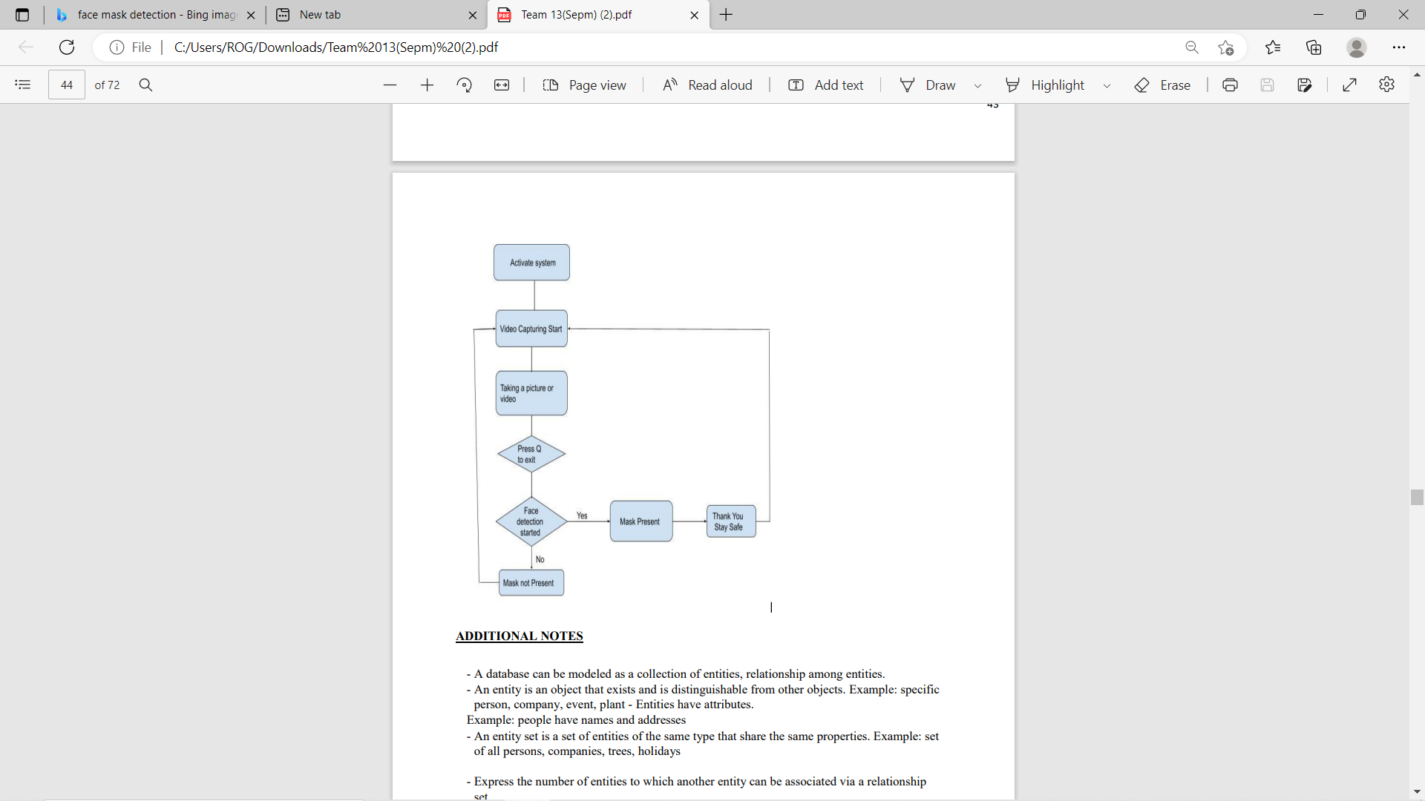
ER Diagram

Slide 20
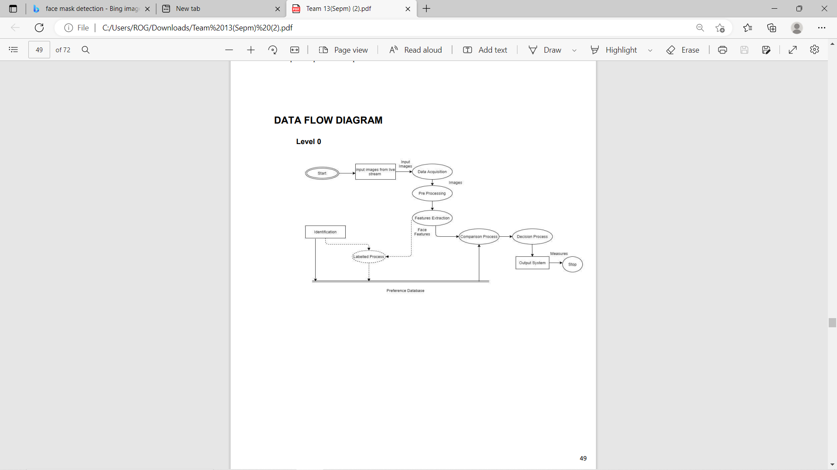
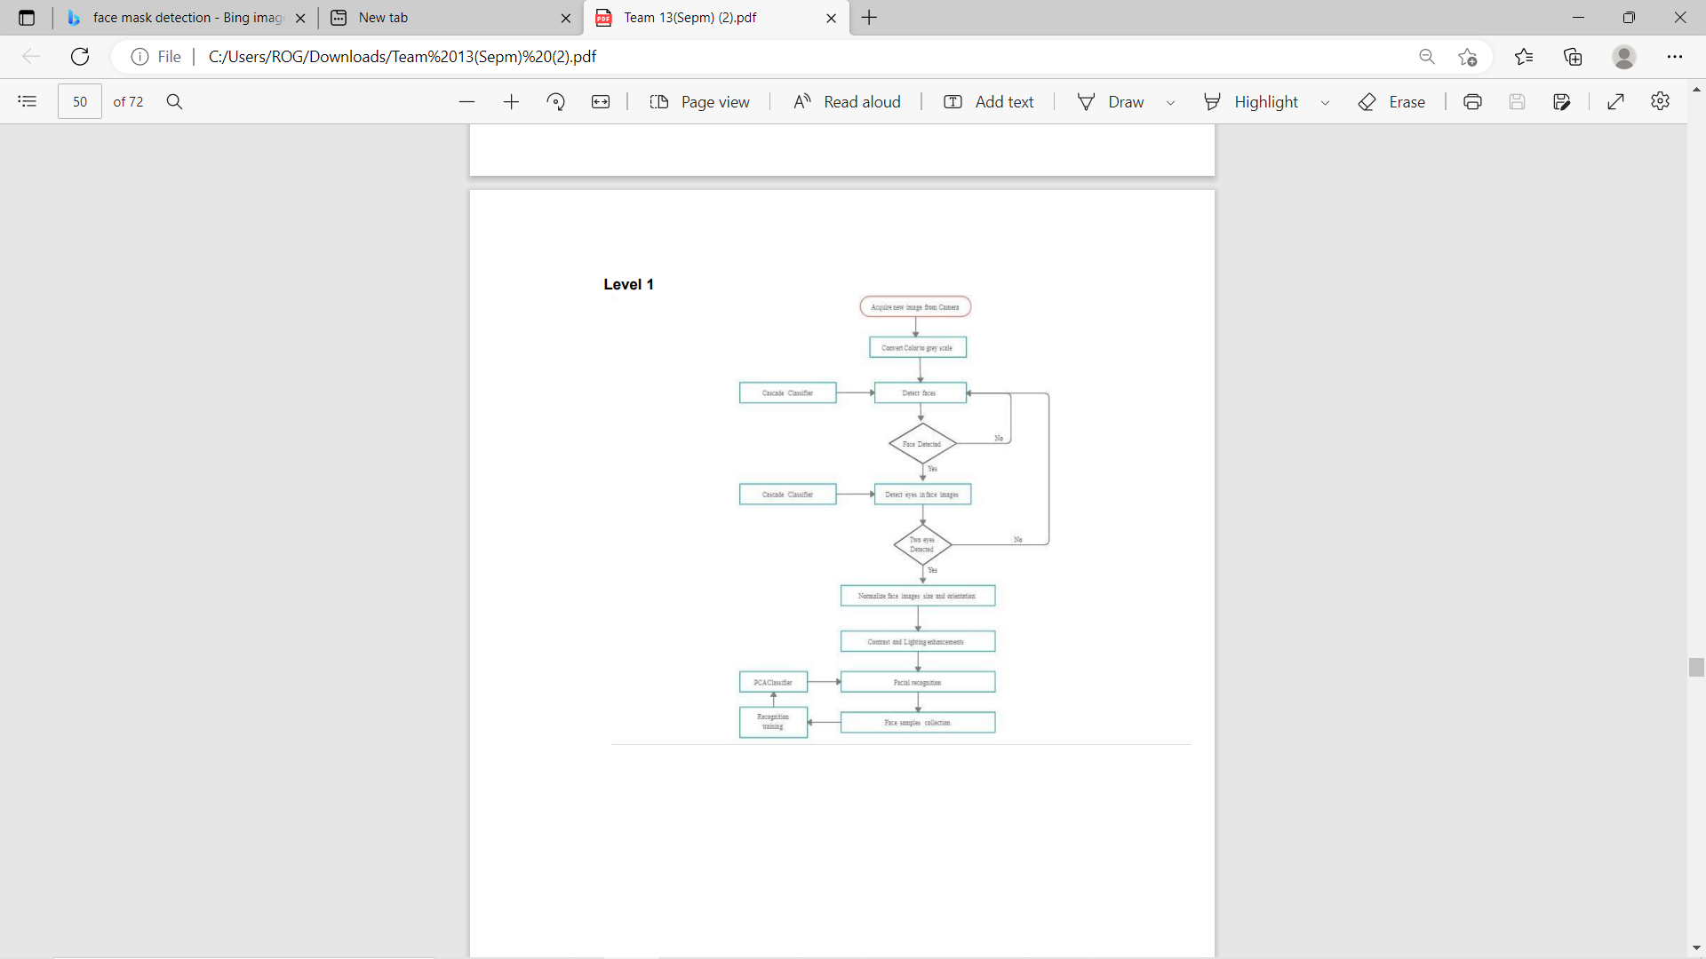
Data flow Diagram

Slide 21
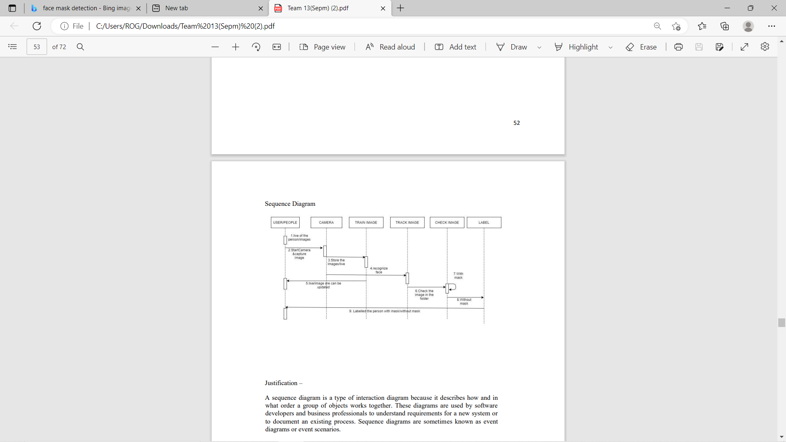
Sequence diagram

Slide 22
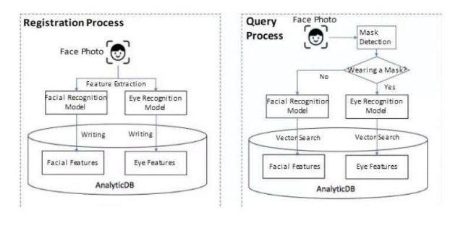
collaboration diagram

Slide 23
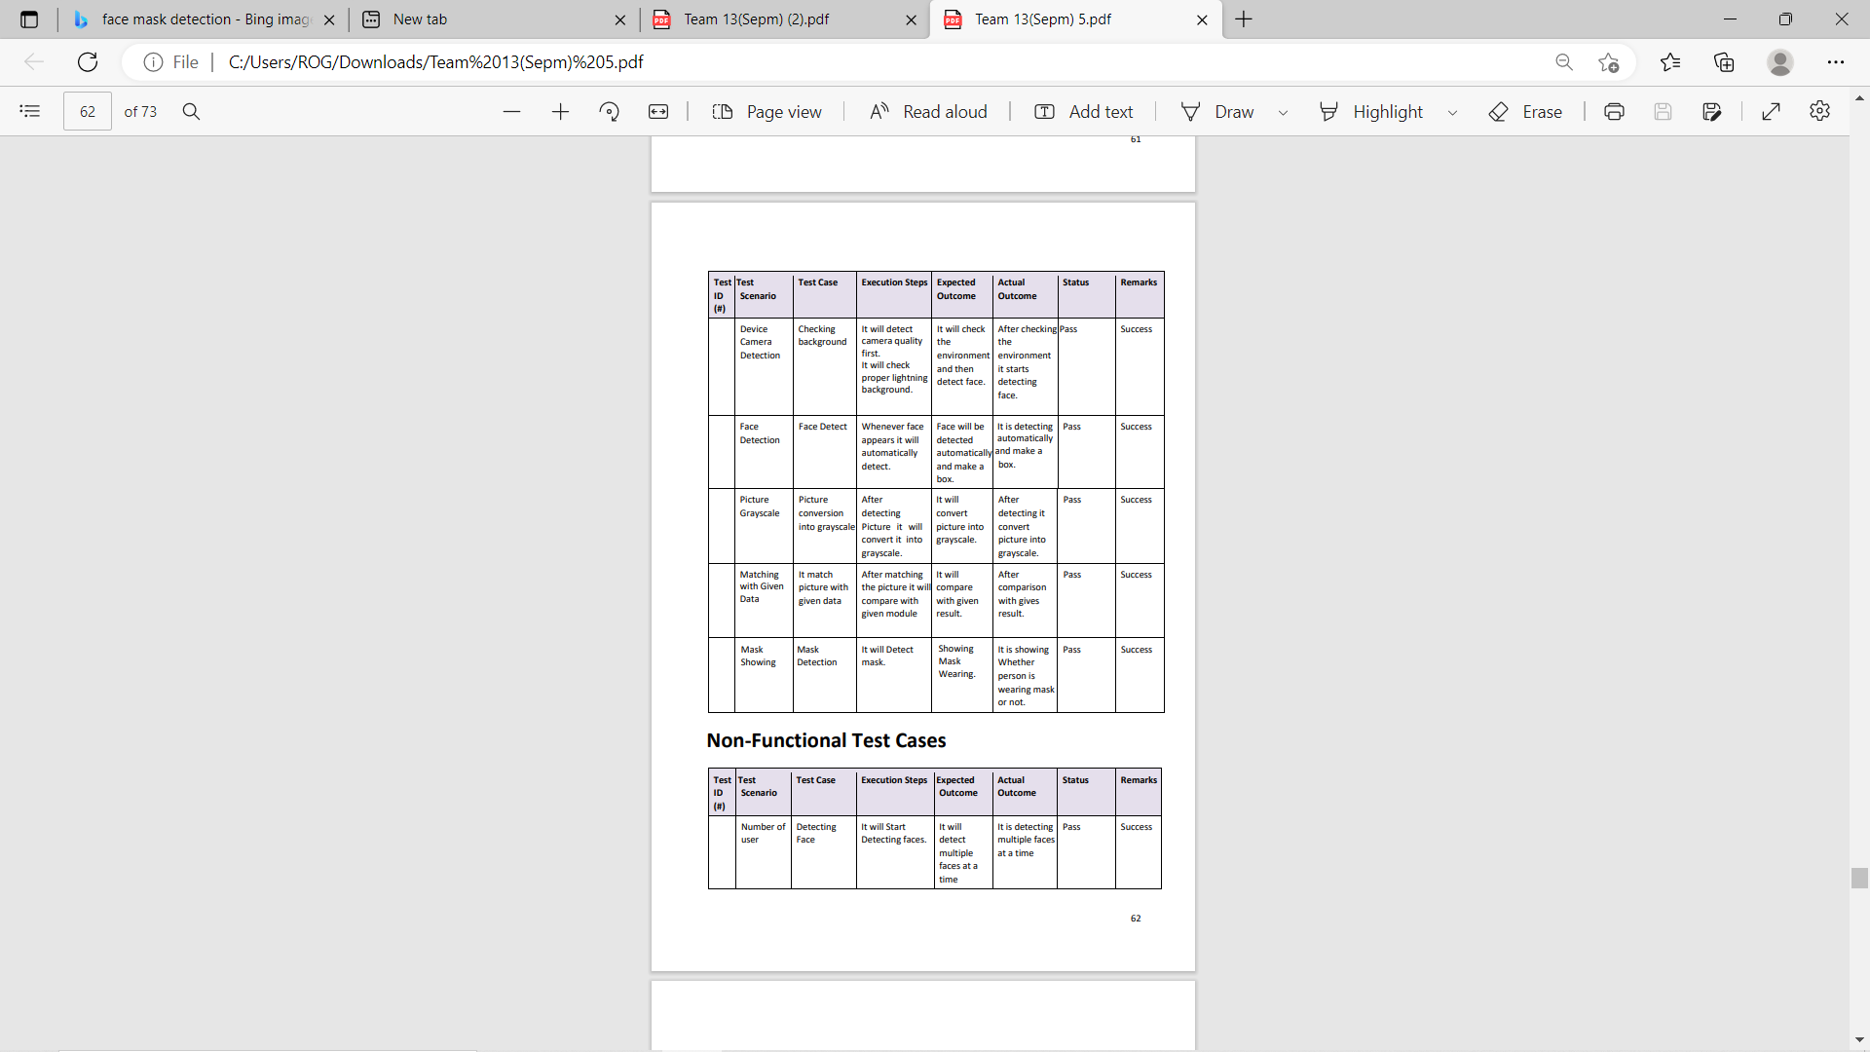
Test cases

Slide 24
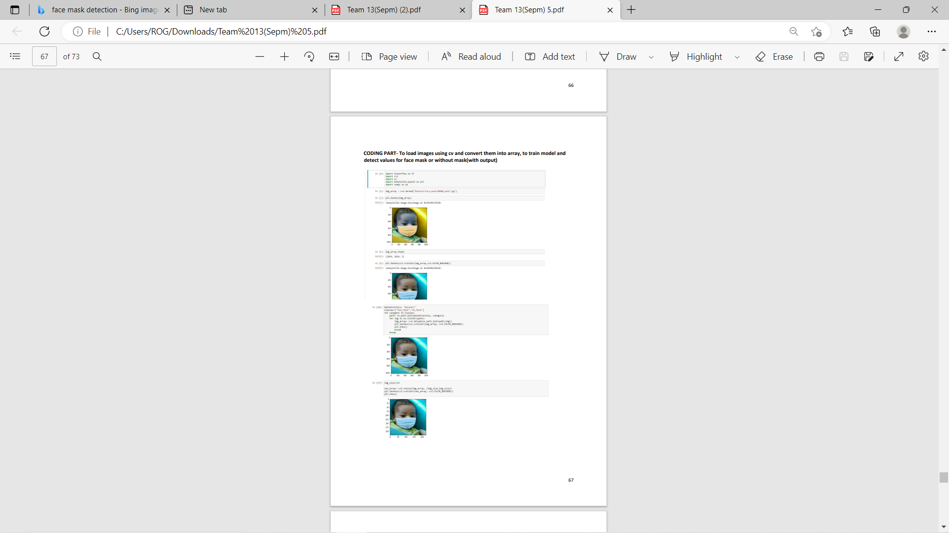
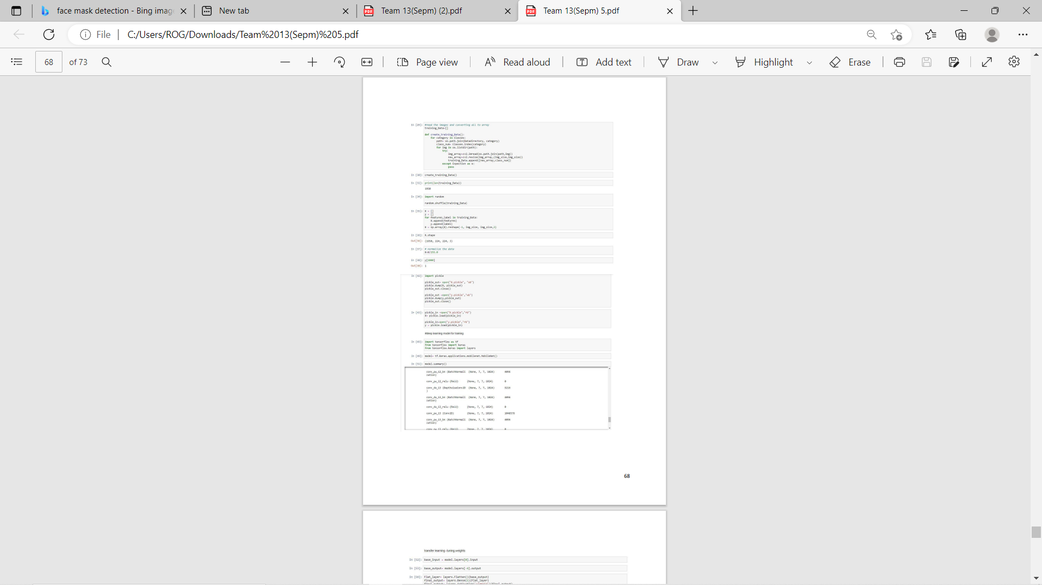
Code with implementation

Slide 25
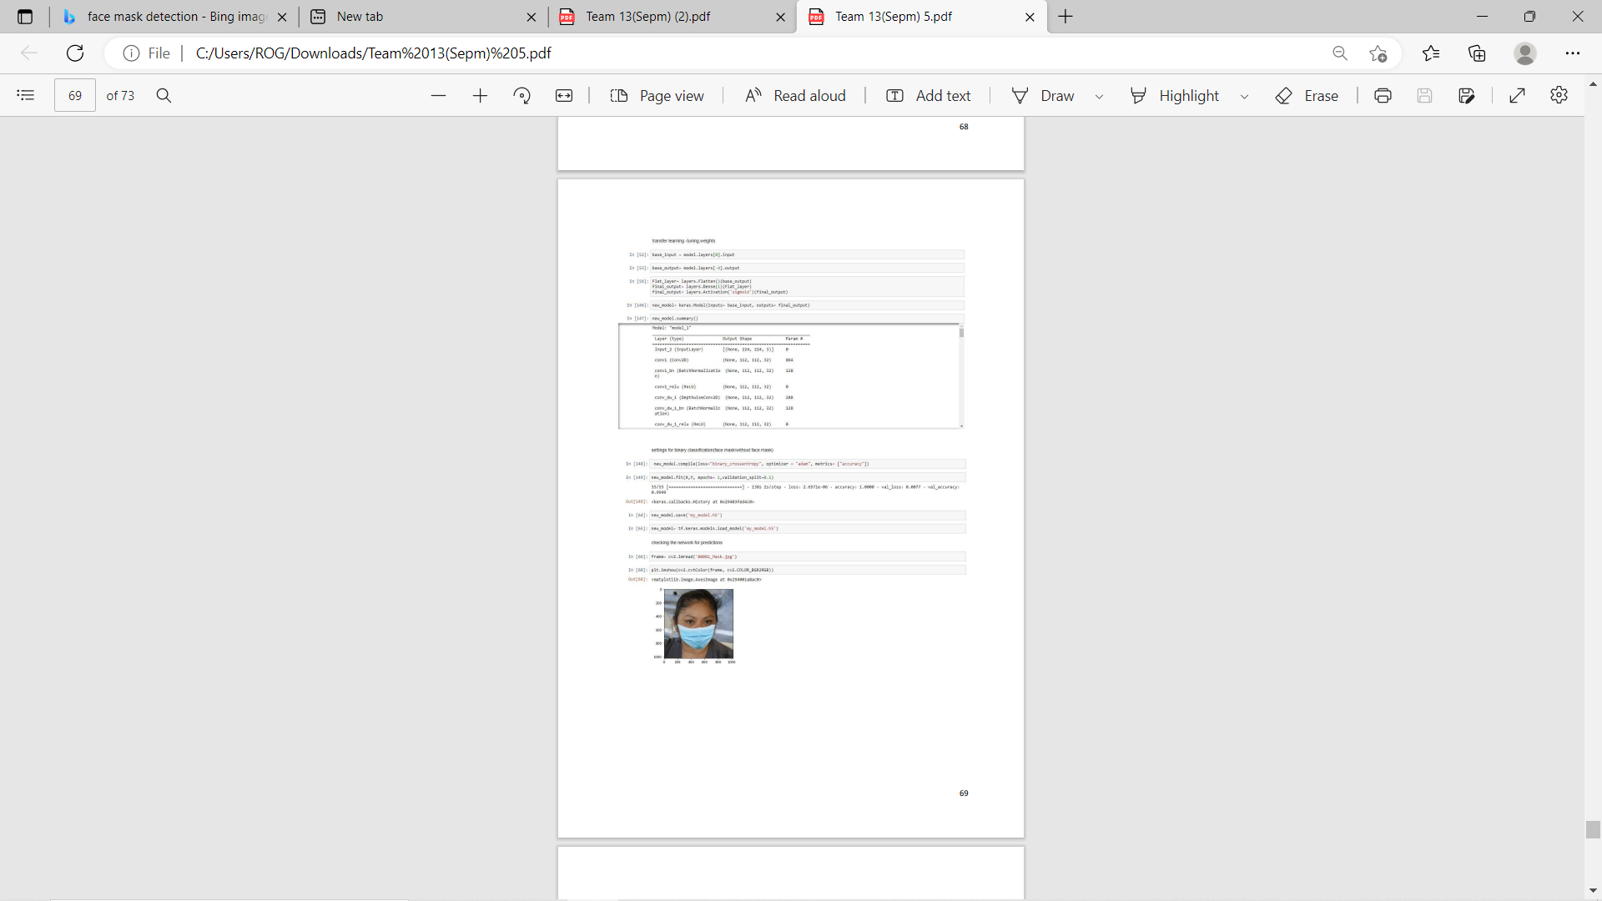
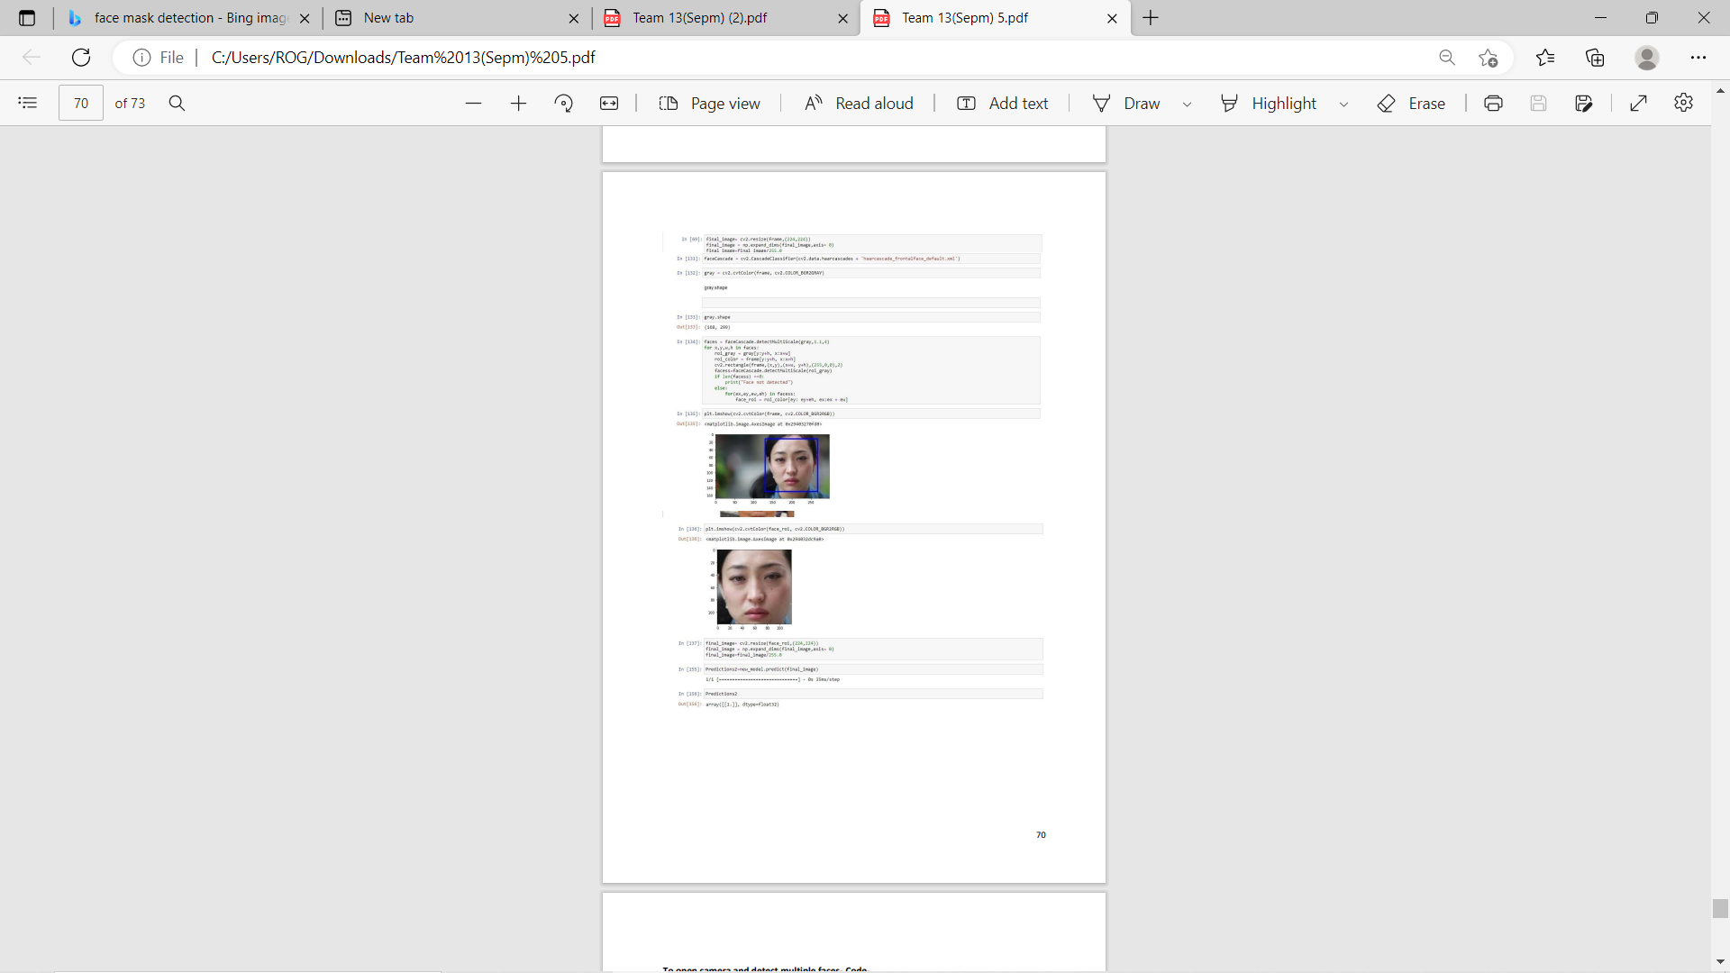
Code with implementation

Slide 26
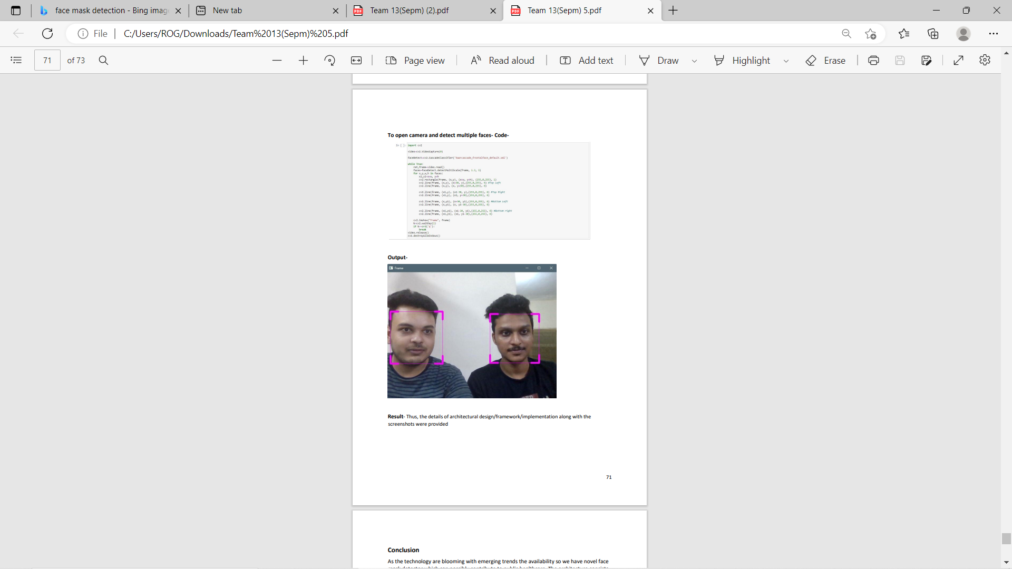
Code with implementation

Slide 27
Conclusion
As the technology are blooming with emerging trends the availability so we have novel face mask detector which can possibly contribute to public healthcare. The architecture consists of Mobile Net as the backbone it can be used for high and low computation scenarios. In order to extract more robust features, we utilize transfer learning to adopt weights from a similar task face detection, which is trained on a very large dataset. We used OpenCV, tensor flow, and NN to detect whether people were wearing face masks or not. The models were tested with images and real-time video streams. The accuracy of the model is achieved and, the optimization of the model is a continuous process and we are building a highly accurate solution by tuning the hyper parameters. This specific model could be used as a use case for edge analytics. Furthermore, the proposed method achieves state-of-the-art results on a public face mask dataset. By the development of face mask-detection we can detect if the person is wearing a face mask and allow their entry would be of great help to the society

